Slide 1
CECOM’s CBM+ Data Delivery for Analysis Plan
Pam Ludwig
Gary Hellenga
CECOM CBM+
Hellenga_Gary@bah.com
CBM+ Files and Messaging Workshop
June 12-14, 2012

Slide 2
CBM+ User Interface (CBM+-UI) System Objectives
Allow Analysts to “browse” CECOM CBM+ Data Repository
Find data associated with specific Assets
Find data associated with specific Models (types)
Focus data to subsets of interest (e.g., by time, by measurement type(s))
Allow Analysts to retrieve datasets of interest
Allow creation/download of ‘spreadsheet’ data file after dataset has been defined
Data file to be exported for use with separate analysis/data mining tools

Slide 3
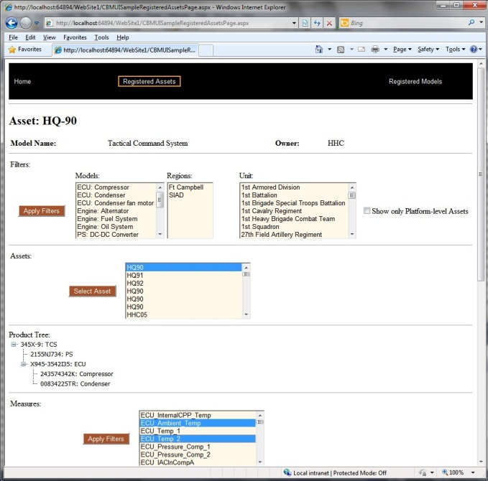

CECOM SEC CBM+-UI System Overview
External systems
(e.g., at LOGSA)
CBM+-UI
CBM+ Data Services
on App Server
Web Server
Browser
SEC CBM+ Data
Repository

Slide 4
CBM+ User Interface Use Scenarios

Slide 5
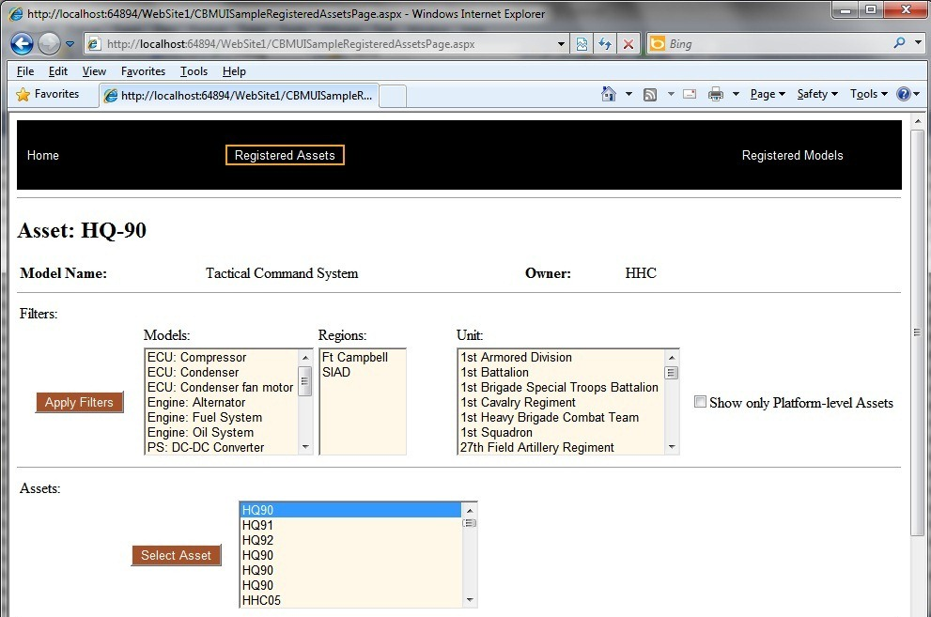
Scenario 1 – Locate Data for a specific Asset
Step 1: Select Asset
Use Filters to create list of Assets for selection.
Click desired Asset and Select Asset; Asset info will be displayed in page header.

Slide 6
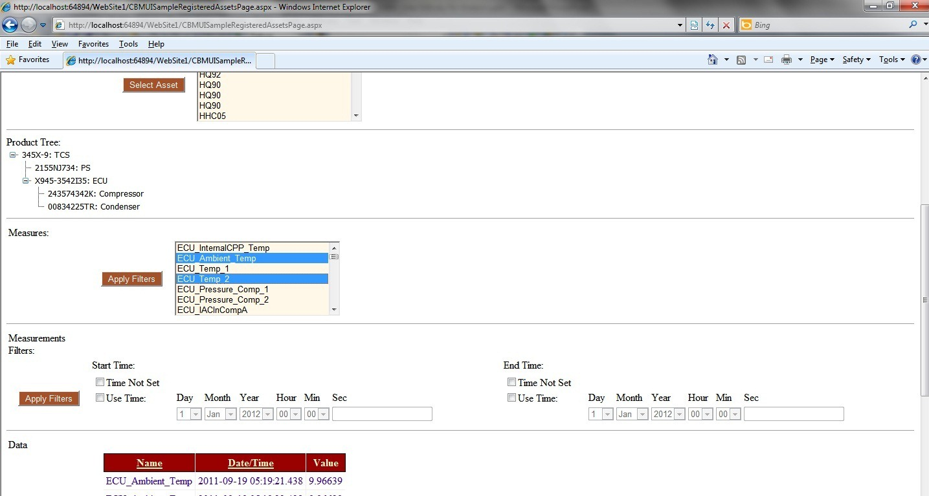
Scenario 1 – Locate Data for a specific Asset
Step 2: Select Measures
Click desired Measure name(s) and Apply Filter
Set Time Period of interest and Apply Filter; resulting data displayed in table at bottom

Slide 7
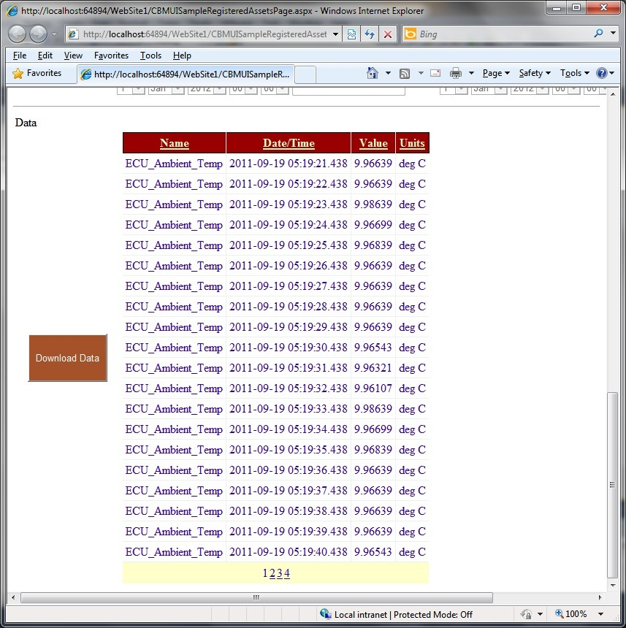
Scenario 1 – Locate Data for a specific Asset
Step 3: View Results
View tabular data page(s).
If desired, click Download Data to save data as CSV file; export to desired analysis tool.

Slide 8

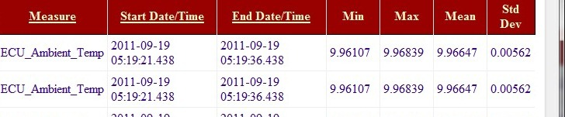
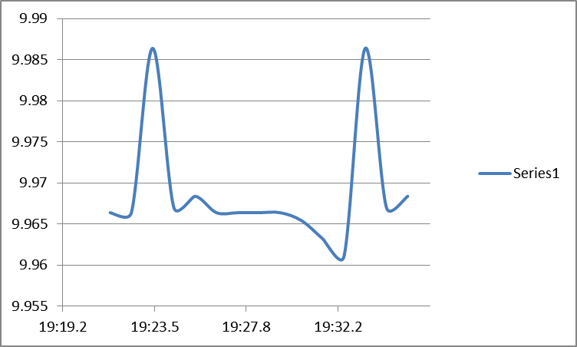
Alternative Display Options for Results
Tabular list of Data Points, one per time point
Tabular list of summarized Data Points, for time intervals
Graphical display of Data Points, for time intervals
(Sample )

Slide 9
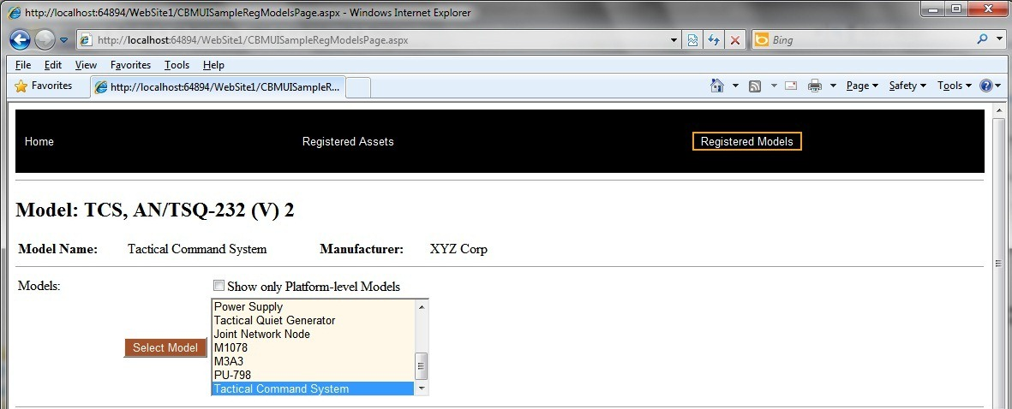
Scenario 2 – Locate Data for a Model (Type)
Step 1: Select Model
Use Filter to limit to only Platform level, or all levels of Models.
Click desired Model and Select Model; Model info will be displayed in page header.

Slide 10
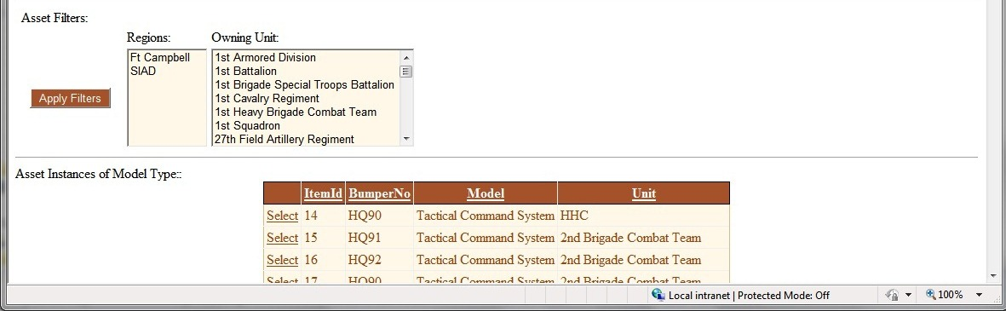
Scenario 2 – Locate Data for a Model (Type)
Step 2: Select Assets
Use Filters to constraint list of Assets of selected Model type
Select individual Assets for inclusion/omission (intend to use checkboxes)

Slide 11
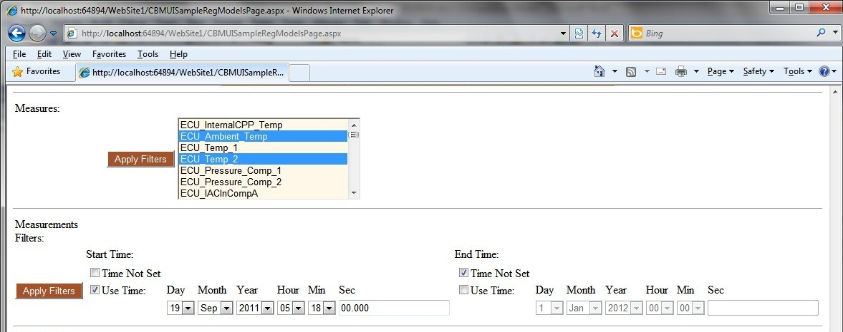
Scenario 2 – Locate Data for a Model (Type)
Step 3: Select Measures
Click desired Measure name(s) and Apply Filter
Set Time Period of interest and Apply Filter; resulting data displayed in table at bottom

Slide 12
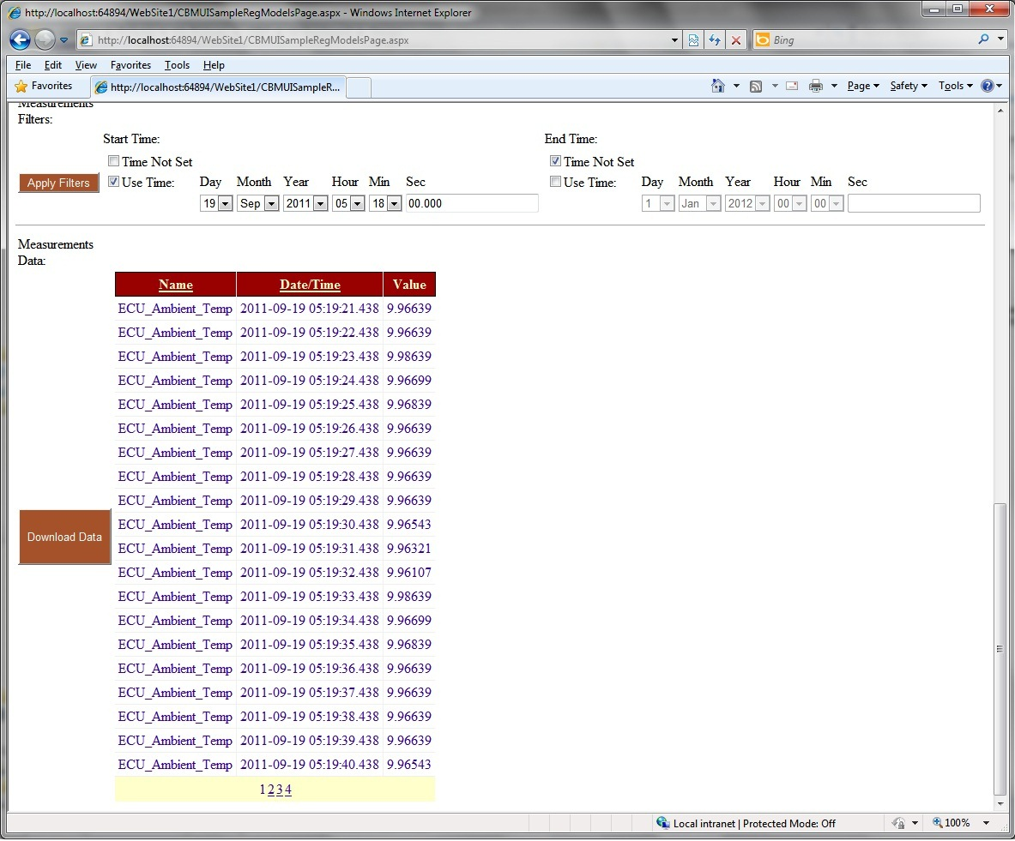
Scenario 2 – Locate Data for a Model (Type)
Step 4: View Results
View tabular data page(s).
If desired, click Download Data to save data as CSV file; export to desired analysis tool.

Slide 13
CBM+-UI Planned Forward Work
Refine graphical displays of large data sets
Investigate capabilities to display data via Product Lifecycle Management toolset (Windchill)
Potential future implementation (post EOA-I)

